Slide 1
Spatial networks

Slide 2
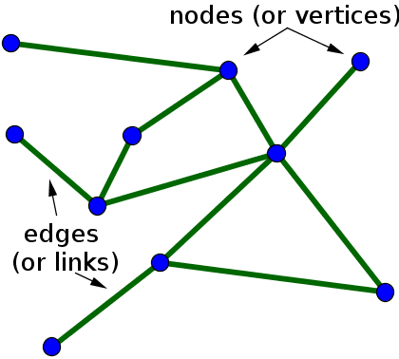
Spatial networks are graphs and graphs are…
Spatial networks
…made of nodes (vertices) and edges
Node
Edge
Edge
Node
Edge
Node

Slide 3
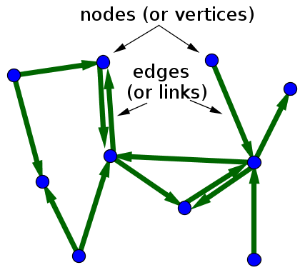
Spatial networks
Spatial networks are graphs and graphs are…
…made of nodes (vertices) and edges
…specified as directed or undirected

Slide 4
Spatial networks
Spatial networks are graphs and graphs are…
…made of nodes (vertices) and edges
…specified as directed or undirected

Slide 5

Spatial networks
Spatial networks are graphs and graphs are…
…made of nodes (vertices) and edges
…specified as directed or undirected
…large scale
https://scitechdaily.com/new-model-explores-exploding-growth-global-transportation-connectivity/

Slide 6
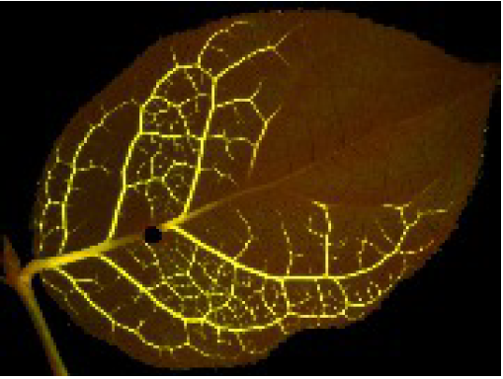
Spatial networks
Spatial networks are graphs and graphs are…
…made of nodes (vertices) and edges
…specified as directed or undirected
…large scale
…or small scale
Re-routing of the flow around an injury in a lemon leaf.
Barthelemy. Spatial Networks
https://arxiv.org/pdf/1010.0302v2.pdf

Slide 7
Spatial networks
What is a spatial network?
A graph whose nodes are embedded in metric space
Distance between nodes is important feature
Geographic distance is often used as the distance metric
https://arxiv.org/pdf/1010.0302v2.pdf

Slide 8
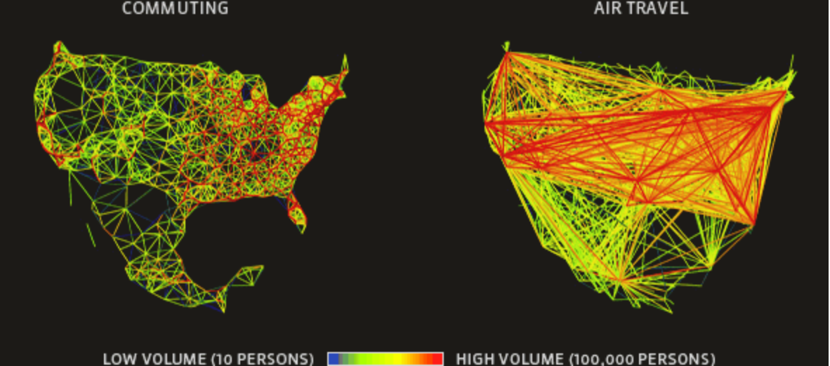
Spatial networks
What is a spatial network?
A graph whose nodes are embedded in metric space
Distance between nodes is important feature
Geographic distance is often used as the distance metric
https://arxiv.org/pdf/1010.0302v2.pdf
http://www.gleamviz.org/model/

Slide 9
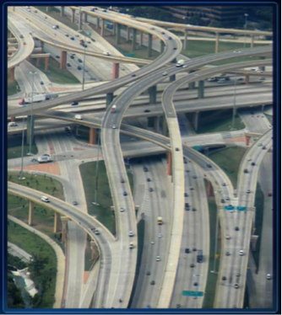
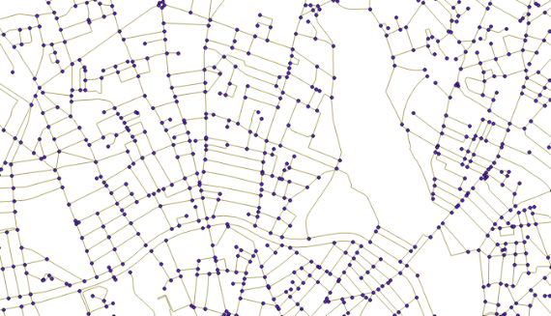
Spatial networks
What is a spatial network?
A graph whose nodes are embedded in metric space
Distance between nodes is important feature
Geographic distance is often used as the distance metric
https://arxiv.org/pdf/1010.0302v2.pdf

Slide 10
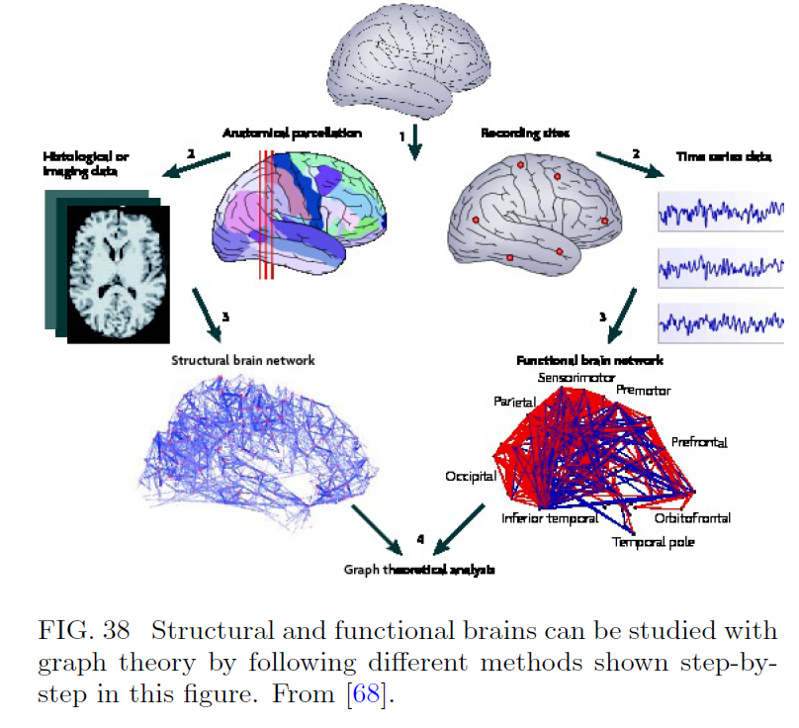
Spatial networks
What is a spatial network?
A graph whose nodes are embedded in metric space
Distance between nodes is important feature
Geographic distance is often used as the distance metric
https://arxiv.org/pdf/1010.0302v2.pdf
Barthelemy. Spatial Networks
https://arxiv.org/pdf/1010.0302v2.pdf

Slide 11
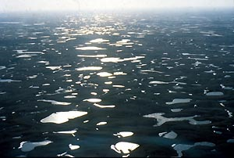
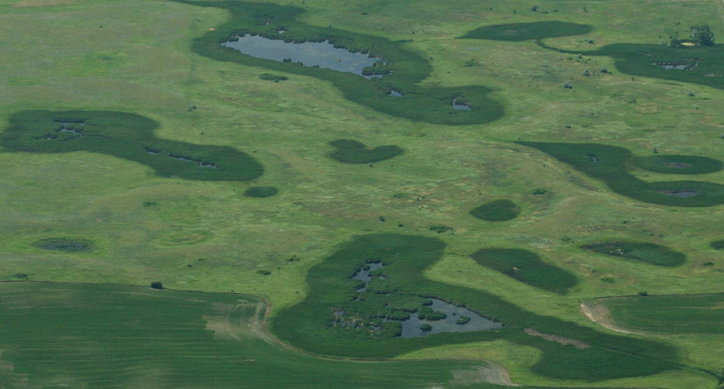
Spatial networks
What is a spatial network?
A graph whose nodes are embedded in metric space
Distance between nodes is important feature
Geographic distance is often used as the distance metric
https://arxiv.org/pdf/1010.0302v2.pdf
US Fish and Wildlife

Slide 12
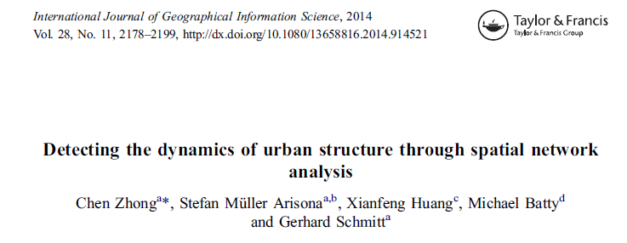
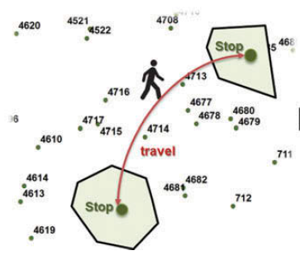
Spatial networks
What is a spatial network?
A graph whose nodes are embedded in metric space
Distance between nodes is important feature
Geographic distance is often used as the distance metric
https://arxiv.org/pdf/1010.0302v2.pdf

Slide 13
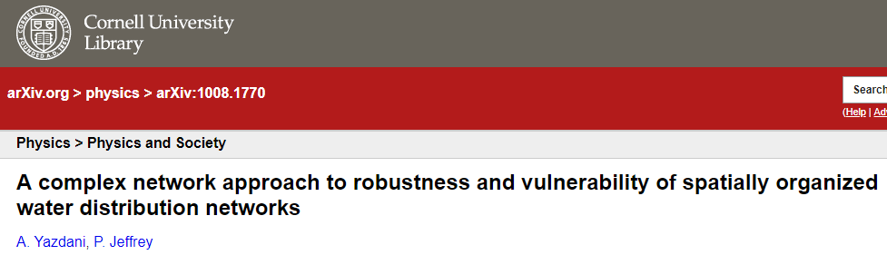
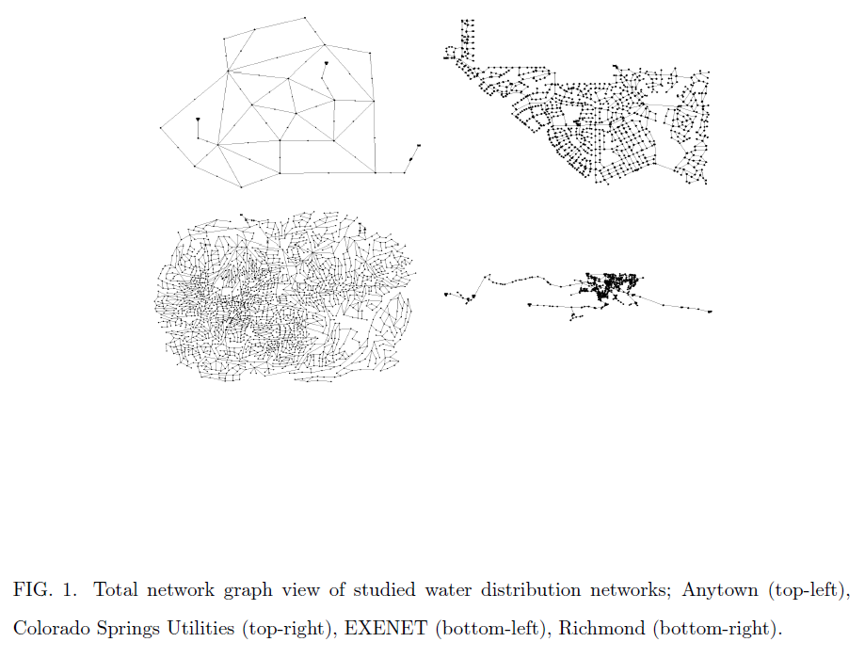
Spatial networks
What is a spatial network?
A graph whose nodes are embedded in metric space
Distance between nodes is important feature
Geographic distance is often used as the distance metric
https://arxiv.org/pdf/1010.0302v2.pdf

Slide 14
Spatial Example

Slide 15
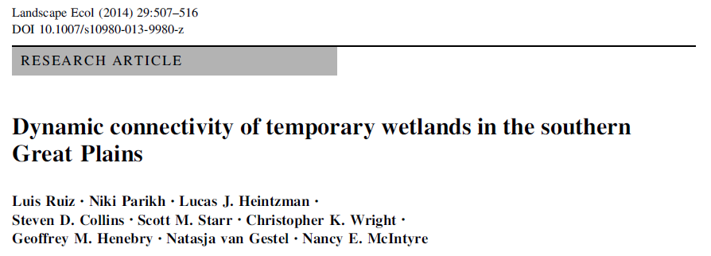
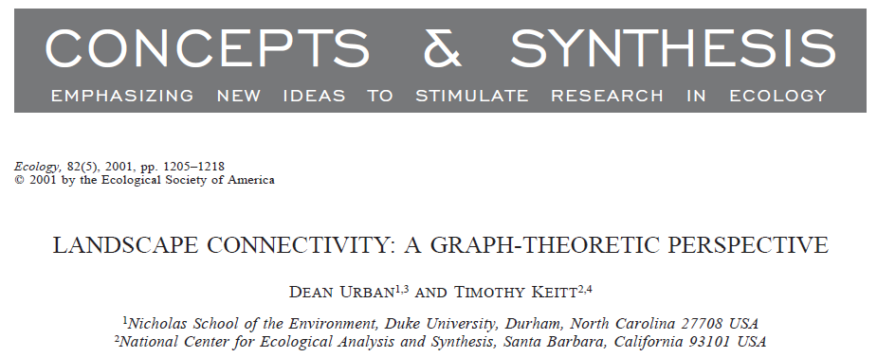
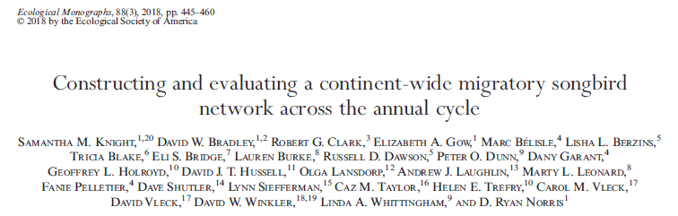
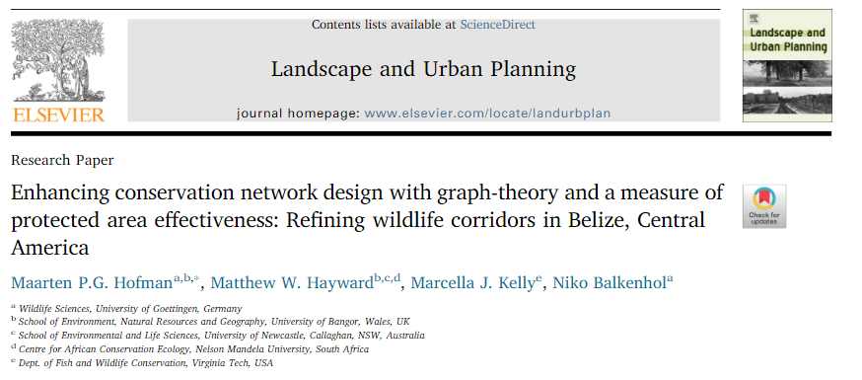
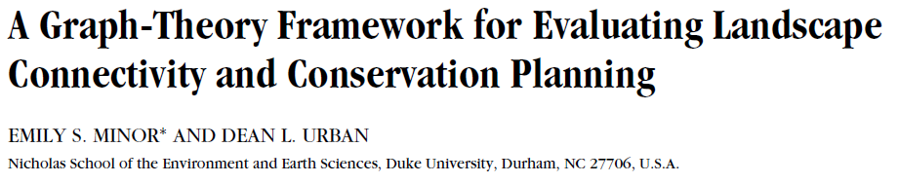
Spatial Network Analysis for Landscape Connectivity
Spatial Example

Slide 16
Spatial Example
Nodes – habitat (wetlands)
Edges- binary, level of connectivity
Spatially explicit
Edge weight
- Distance
- Resistance
- Directed or undirected
Minor and Urban. 2008. Cons. Biol. 22:297-307.

Slide 17
Spatial Example
Connectivity Metrics
Network
Number of nodes
Graph density
Graph diameter
Characteristic (average) path length
Clustering coefficient (global transitivity)
Node
Degree: # of neighbors
Transitivity (local clustering)
Betweenness centrality: # of paths that pass through a node
Distance to nearest neighbor
Hubs
Cutpoints

Slide 18
Network Metrics
Spatial Example
Metric | Definition and Interpretation
Number of Nodes | The number of nodes in a network.
Graph Density/ Linkage Density | The number of links in a network / the number of possible links.
Graph Diameter | Maximum distance between all pairs of nodes; larger values indicate that more nodes must be traversed to travel through the network Short diameter implies fast movement through the network. This could be beneficial (dispersal is easy) or detrimental (spread of disease) for the focal organism. ª
Characteristic Path Length (CPL) | The average shortest path length over the network. Short CPL means that all patches tend to be easily reachable, implying patchy population rather than metapopulations or subpopulations. ª
Transitivity (global)/ Clustering coefficient | Frequency of loops of length 3 in the network. Larger values indicate the presence of more groups of nearby wetlands.
ª from Minor & Urban 2008

Slide 19
Node Metrics
Spatial Example
Metric | Definition and Interpretation
Degree | Number of neighbors connected to a node. Low-degree patches may be vulnerable to extinction if neighboring patches are developed. High-degree patches may be population sources or sinks, depending on size and quality of patch. ª
Local transitivity | Measurement of whether the nodes in a cluster are connected to each other. Larger values indicate that a given node is more embedded within a cluster. Highly clustered nodes facilitate dispersal and spread of disturbances. They may be more resilient to patch removal due to many redundant pathways. ª
Betweenness centrality | Number of the shortest paths between other nodes that pass through a given node. Larger values indicate nodes that act as stepping-stones among clusters in the network.
ª from Minor & Urban 2008

Slide 20
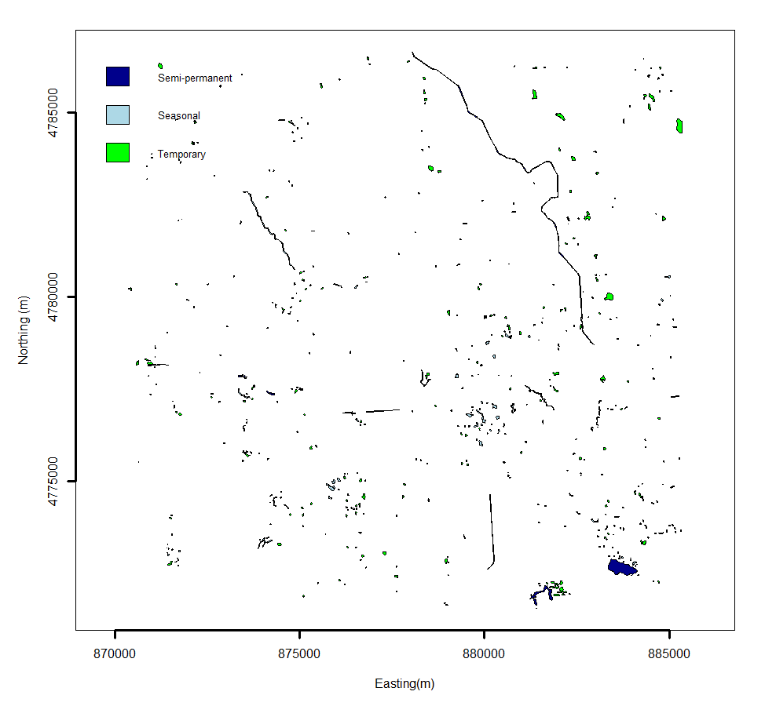
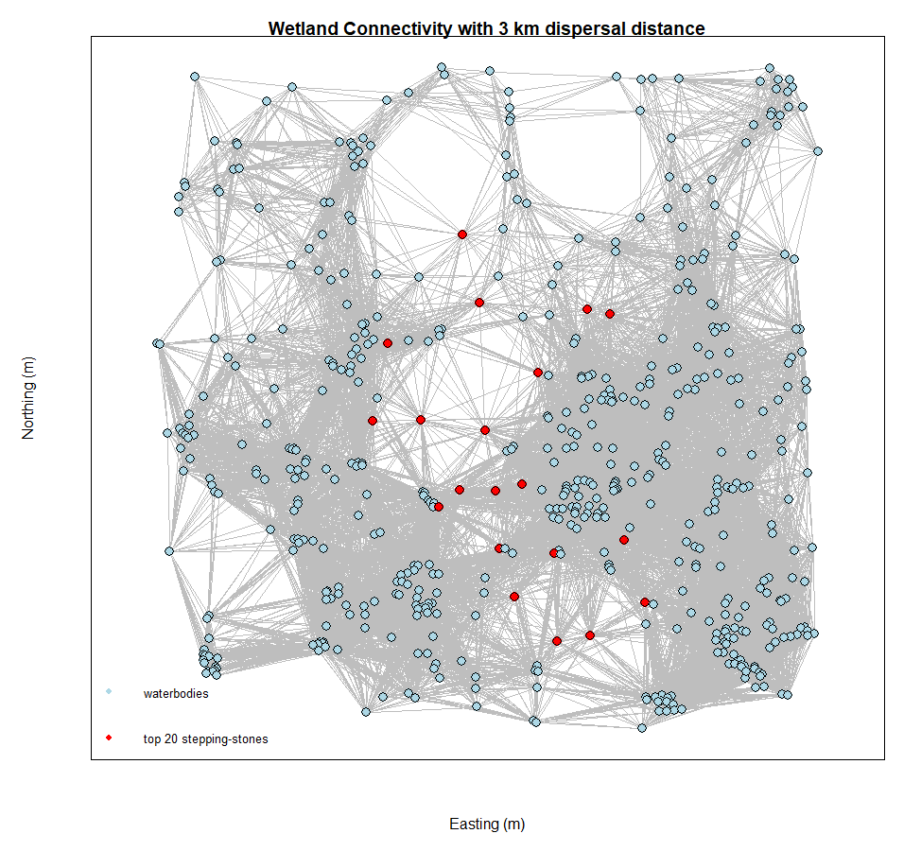

Example Wetlands
Spatial Example
N. Leopard Frog (Lithobates pipiens)

Slide 21
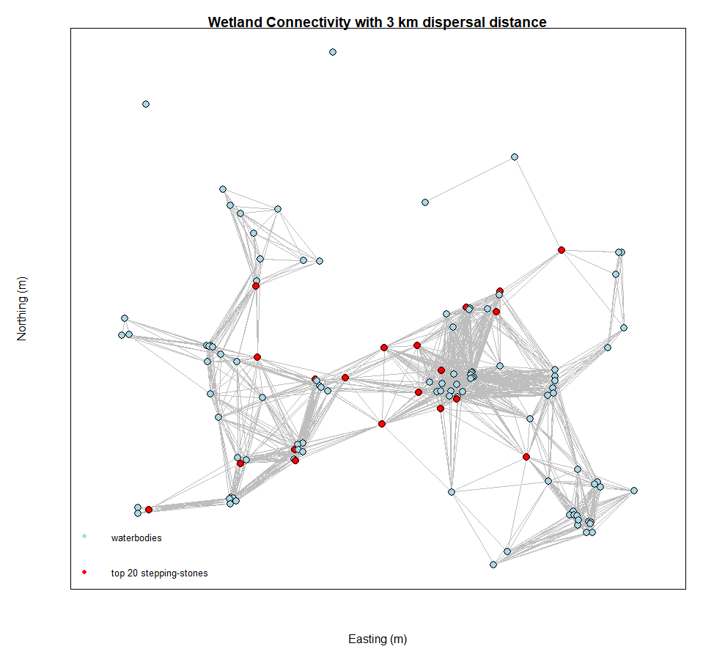
Example Wetlands
Spatial Example
With no TEMPORARY wetlands
N. Leopard Frog (Lithobates pipiens)

Slide 22
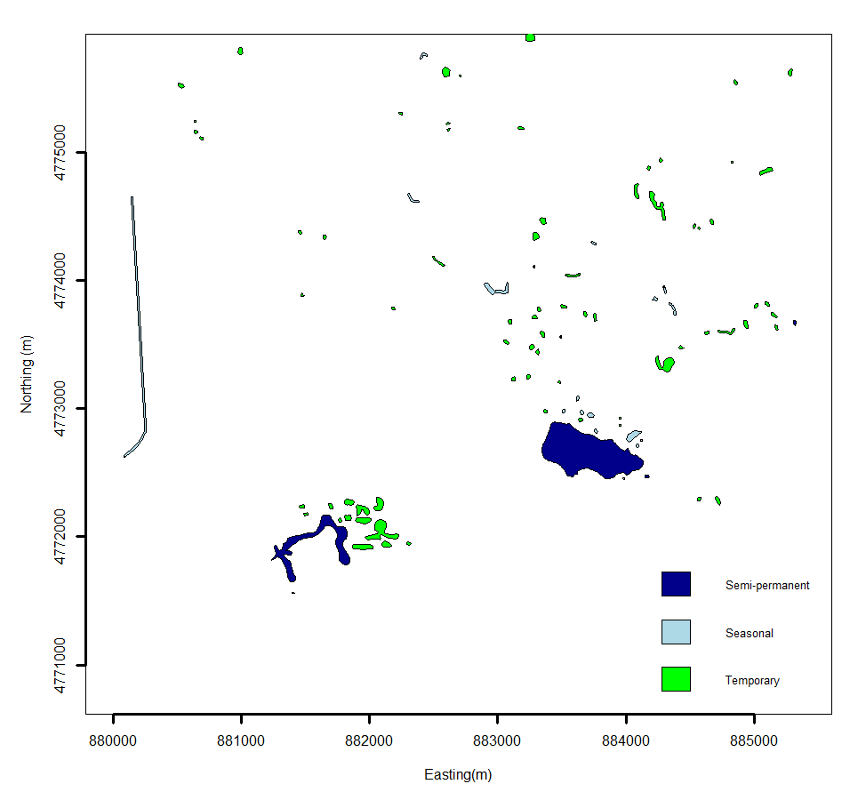
Example Wetlands
Spatial Example

Slide 23
Spatial Example
R script

